Slide 1
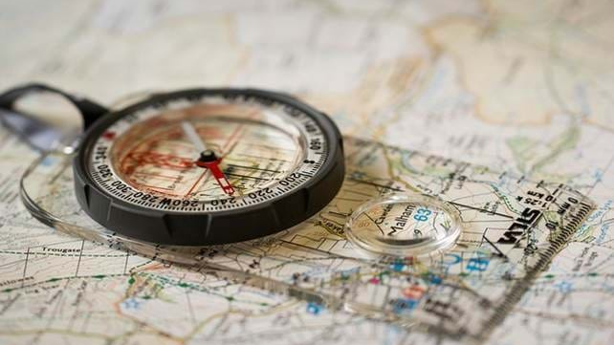
Map Skills

Slide 2
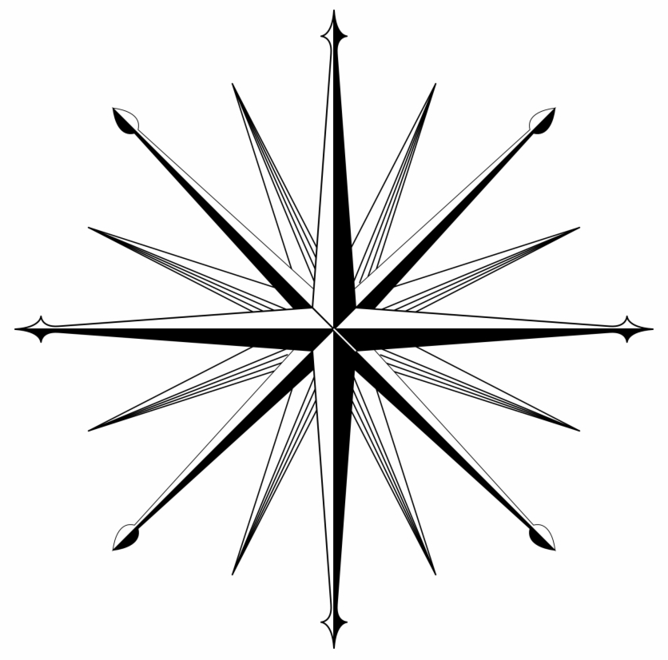
The 16 Point Compass

Slide 3
The 16 Point Compass
N

Slide 4
The 16 Point Compass
N
E

Slide 5
The 16 Point Compass
N
E
S

Slide 6
The 16 Point Compass
N
W
E
S

Slide 7
The 16 Point Compass
N
NE
W
E
S

Slide 8
The 16 Point Compass
N
NE
W
E
SE
S

Slide 9
The 16 Point Compass
N
NE
W
E
SW
SE
S

Slide 10
The 16 Point Compass
N
NW
NE
W
E
SW
SE
S

Slide 11
The 16 Point Compass
N
NW
NNE
NE
W
E
SW
SE
S

Slide 12
The 16 Point Compass
N
NW
NNE
NE
ENE
W
E
SW
SE
S

Slide 13
The 16 Point Compass
N
NW
NNE
NE
ENE
W
E
ESE
SW
SE
S

Slide 14
The 16 Point Compass
N
NW
NNE
NE
ENE
W
E
ESE
SW
SE
SSE
S

Slide 15
The 16 Point Compass
N
NW
NNE
NE
ENE
W
E
ESE
SW
SE
SSW
SSE
S

Slide 16
The 16 Point Compass
N
NW
NNE
NE
ENE
W
E
WSW
ESE
SW
SE
SSW
SSE
S

Slide 17
The 16 Point Compass
N
NW
NNE
NE
WNW
ENE
W
E
WSW
ESE
SW
SE
SSW
SSE
S

Slide 18
The 16 Point Compass
N
NW
NNW
NNE
NE
WNW
ENE
W
E
WSW
ESE
SW
SE
SSW
SSE
S

Slide 19
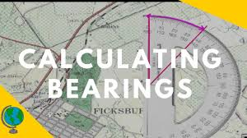
Bearings

Slide 20
Bearings
Scout Hut
N
My House

Slide 21
Bearings
Scout Hut
N
N
My House

Slide 22
Bearings
Scout Hut
N
N
My House

Slide 23
Bearings
Scout Hut
N
N
My House

Slide 24
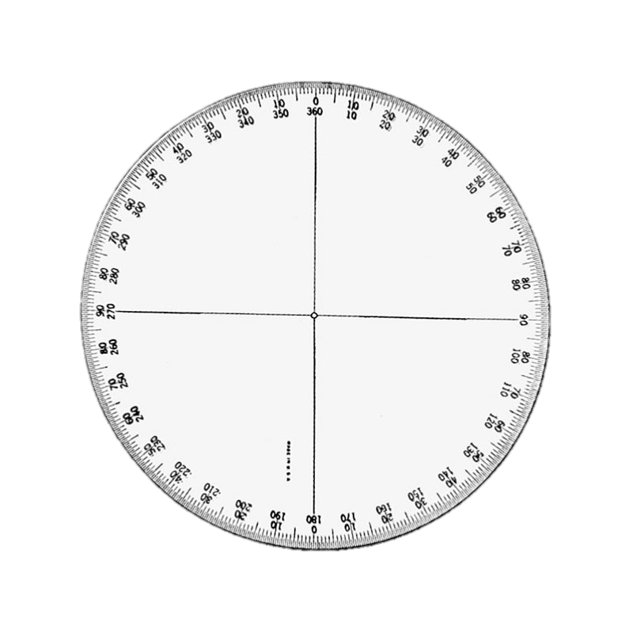
Bearings
Scout Hut
N
N
My House

Slide 25
Bearings
Scout Hut
N
N
Angle = 55º
My House

Slide 26
Bearings
Scout Hut
N
N
Angle = 55º
Bearing = 055º
My House

Slide 27
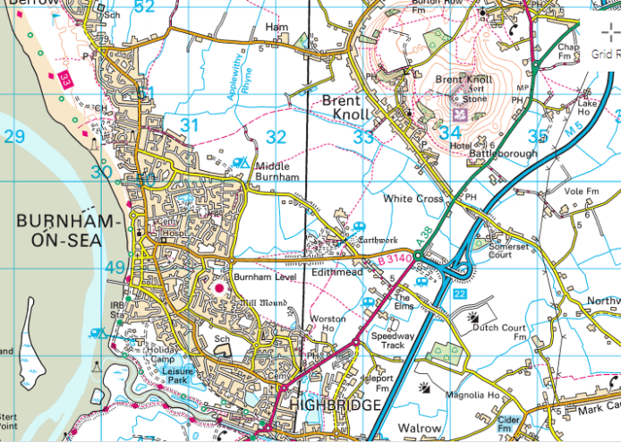
Grid References

Slide 30
Coordinate = (314,

Slide 31
Coordinate = (314,

Slide 32
Coordinate = (314, 481)

Slide 33
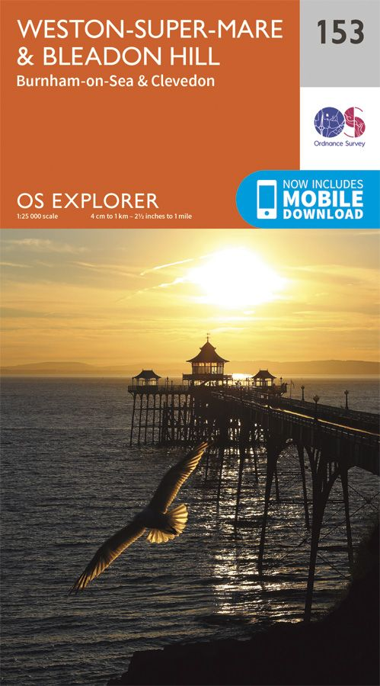
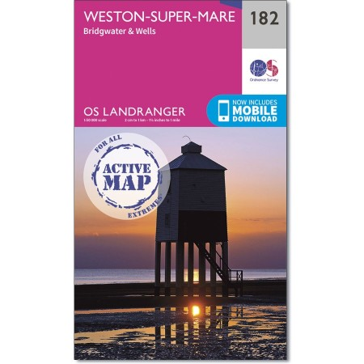
Scale

Slide 34
Scale
Different maps have different Scales
Most common are 1:25,000 and 1:50,000 we will mostly use 1:25,000

Slide 35
Scale
Different maps have different Scales
Most common are 1:25,000 and 1:50,000 we will mostly use 1:25,000
1:25,000 means that every 1cm you measure on your map represents 25, 000 cm in real life, 1m = 100cm so 25,000cm = 250m

Slide 36
Scale
Different maps have different Scales
Most common are 1:25,000 and 1:50,000 we will mostly use 1:25,000
1:25,000 means that every 1cm you measure on your map represents 25, 000 cm in real life, 1m = 100cm so 25,000cm = 250m
1:50,000 means that every 1cm you measure on your map represents 50, 000 cm in real life, 1m = 100cm so 50,000cm = 500m

